Slide 1
Committing to Accessibility in the Licensing of Digital Resources
BCLA Conference, April 24, 2024
1:45 am – 2:30 pm
Notes:
Laurie

Slide 2
Land Acknowledgement
We are presenting today on the traditional, ancestral, and unceded territory of the xʷməθkʷəy'əm (Musqueam), Skwxwú7mesh (Squamish), and səlilwətaɬ (Tsleil- Waututh) Peoples. We respect and affirm the inherent and Treaty Rights of all Indigenous Peoples and will continue to honour the commitments to self-determination and sovereignty we have made to Indigenous Nations and Peoples.

Slide 3
Our Presenters
Laurie Davidson, Executive Director, Centre for Equitable Library Access (CELA)
Laetitia Mfamobani, Accessibility Consultant, National Network for Equitable Library Service (NNELS)
Tami Setala, Licensing & Business Development Manager, BC Libraries Cooperative
Notes:
Laurie

Slide 4
Outline
Overview of the Public Library Accessibility Resource Centre (PLARC) Project.
User Perspective and Demonstrations.
Licensing Approaches to Accessibility.
Questions.

Slide 5
Public Library Accessibility Resource Centre (PLARC) Project
This collaborative project is funded by the Government of Canada, co-led by NNELS and CELA in partnership with eBOUND.
The goal of the project is to create a consolidated resource centre focused on the education and training of library staff across the country on the importance of accessibility.
Notes:
Laurie
CELA and NNELS offer nationally accessible reading services through public libraries in Canada.
eBOUND is a non-profit that enables independent Canadian publishers to engage in the digital marketplace.

Slide 6
Background in Canada
Department of Canadian Heritage Accessible Books Funding: 22.8 Million over 5 years (2019-24).
  Administered through the Canada Book Fund.
  Support the production and distribution of accessible digital books by Canadian independent publishers.
  This funding is what is supporting PLARC, and to encourage born-accessible paradigm within public libraries and to build accessibility into all aspects of service.
Notes:
Laurie
Born accessible: Accessible from the get-go and the content does not require remediation.

Slide 7
Accessibility in Mainstream Public Library Services
No one-size fits all solution (rural/urban, large/small etc.).
Historically, accessibility has been done as part of a separate service or organization (homebound services, CELA and NNELS).
Challenge is to envision new ways to provide inclusive, mainstream service for people with disabilities that has accessibility built into it.
Notes:
Laurie

Slide 8
Statistics on Disabilities
27% of Canadians aged 15 years and older, or 8.0 million people, have one or more disabilities - 2022 Canadian Survey on Disability.
5.2 million Canadians have difficulty reading print material - Print Material Accessibility in Canada, 2023.
Notes:
Laurie

Slide 9
Diverse Disabilities
Cognitive/Learning/Speech.
Physical/Mobility.
Blindness/Low Vision.
Intellectual.
Hearing.
Mental Health.
Invisible.
Notes:
Laurie: Some of these are Print Disabilities – vision, mobility, comprehension, which is what CELA and NNELS support through their services, but this project encompasses all disabilities.

Slide 10
PLARC Project: 2021
Formation of a Library Advisory Group in 2021.
Survey of library staff in Canada in 2021.
  Over 500 responses.
  95% say they need training on how to help people with disabilities.
Formation of AccessibleLibraries.ca / BibliosAccessibles.ca
Notes:
Laurie

Slide 11
PLARC Project: To Date
Presentations at library conferences.
Is Your Public Library Accessible study (2022-2023).
    Collect, learn about, and value the public library experiences of people with all types of disabilities across Canada.
    Participants were asked to use their local public library and report back on their experiences through surveys and focus groups.
Notes:
Laurie

Slide 12
PLARC Project: Resources
Curation and creation of resources for AccessibleLibraries.ca / BibliosAccessibles.ca.
  213 total resources (170 English, 43 French).
    155 curated resources from organizations and websites.
    58 resources created by the project.
    12 learning paths for getting started.
Notes:
Laurie

Slide 13
Newest Resource
The creation of the Considering Accessibility when Procuring Licensed Digital Resources guide was identified as a need for library staff and libraries.
  Includes practical recommended considerations.

Slide 14
5 Key Takeaways
  All libraries have a part to play in the process: whether a library procures individually, through a regional system or through a consortium.
  Advocate for accessibility with vendor, advocate internally, advocate with your consortium.
  Be specific about accessibility requirements in RFI/RFPs, informal requests and licenses.
Notes:
Laurie

Slide 15
5 Key Takeaways (con’t)
  Accessibility includes both content and platform.
  Hire and consult with people with lived experience with a disability.
Notes:
Laurie

Slide 16
User Perspective & Demonstrations
Laetitia Mfamobani,
NNELS Accessibility Consultant
Notes:
Laetitia

Slide 17
Common Barriers 1
Accessibility barriers found in Licensed Digital Resources are grouped in two main areas:
Area 1:
  The full search and discovery experience is not always available to all devices or software.

Slide 18
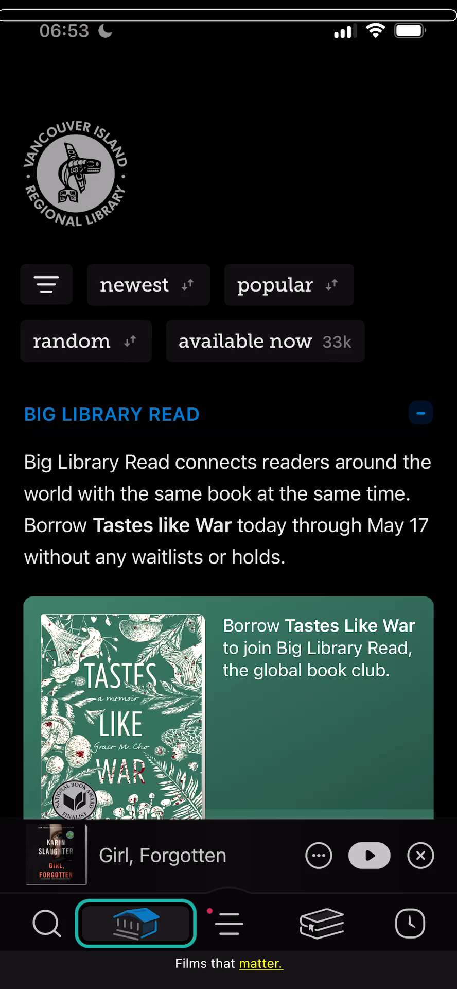
Demo 1: Inaccessible Libby Platform

Slide 19
Common Barriers 2
Area 2:
  The content itself is not always fully accessible.

Slide 20
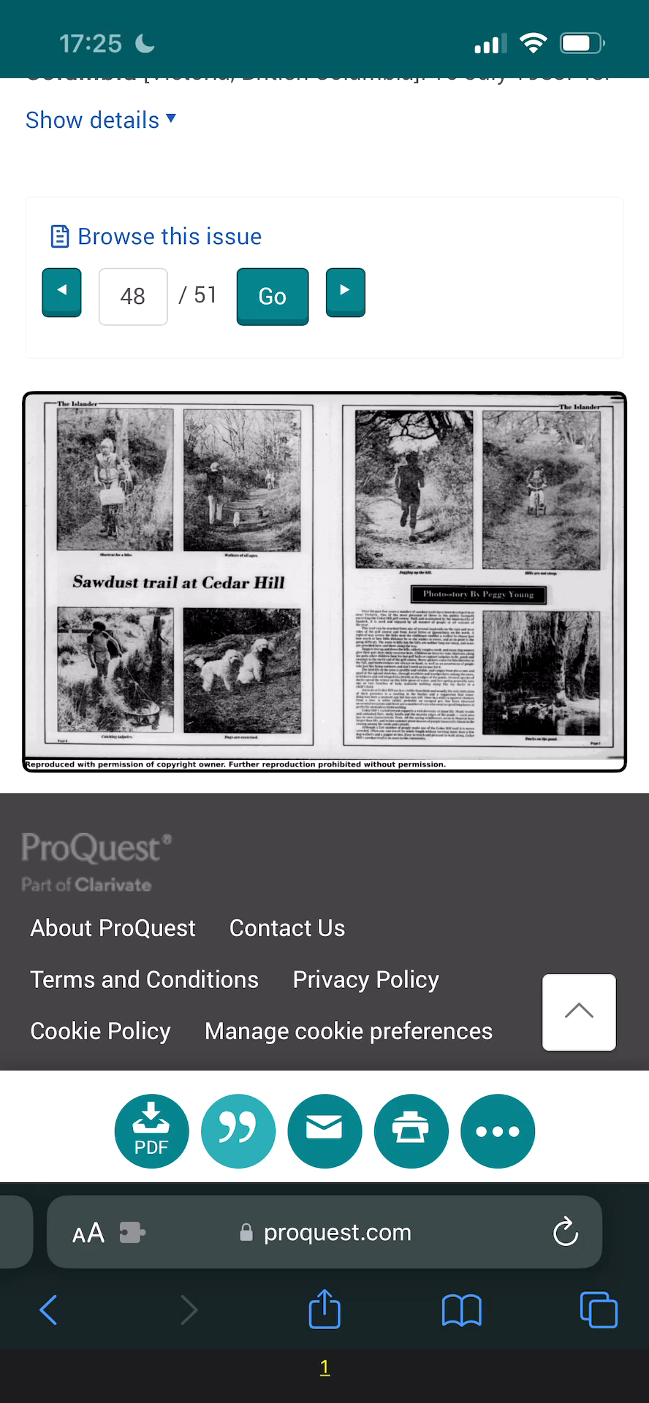
Demo 2: Inaccessible Content Proquest

Slide 21
Combined Barriers
Sometimes both the content and the platform have accessibility barriers.

Slide 22
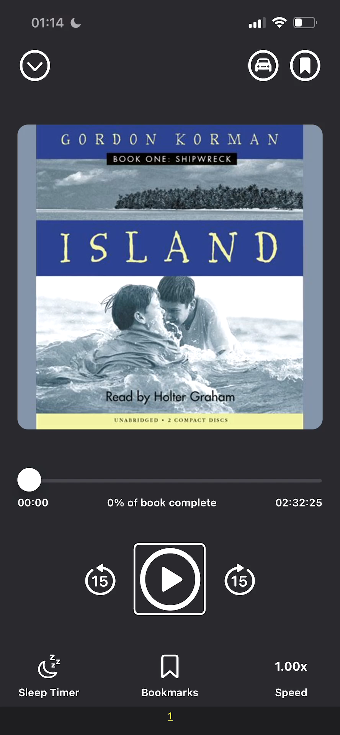
Demo 3: Hoopla Audiobook Player

Slide 23
Determining Accessibility of Vendor Products
Visit AccessiblePublishing.ca to access a number of library apps and websites that have been assessed for accessibility by skillful and experienced accessibility consultants with lived experience.
Ask the vendor to do their own accessibility audit/testing of the digital resource and provide a report and explanation of their process
Ask the vendor for testing access to the digital resource so the library can do their own accessibility testing.

Slide 24
Testing Approach 1/3
Accessibility Testers use a holistic approach to ensuring full accessibility and usability of the digital resources:
All controls are accessible.
The content is readable using assistive technologies.

Slide 25
Testing Approach 2/3
Visual customization options are available.
There are non-colour alternatives for information conveyed only through colour.
Images have descriptive text
There are multiple options for accessing multimedia

Slide 26
Testing Approach 3/3
The resource does not prescribe how users use it.
The digital resource (reading platform, website, or app) has navigational skip links.
Users can determine where they are in the digital content or interface.

Slide 27
Licensing Approaches to Accessibility
Tami Setala, Licensing & Business Development Manager, BC Libraries Cooperative
Notes:
Tami

Slide 28
Licensing Approaches to Accessibility: Outline
Overview of the processes for engaging with vendors.
  Formal vs informal processes.
Accessibility Impact Assessments.
Model License Agreements.
Advocacy.
Notes:
Outline of presentation

Slide 29
Processes For Engaging with Vendors
Formal vs informal.
  Requests for Proposal (RFP).
  Informal processes.
    What has the vendor already done?
    What more do we need from them?
Notes:
Most digital resource vendors want their resources to be accessible. It’s good for business and they need to comply with accessibility legislation.

Slide 30
Request for Proposal (RFP)
Used for identifying options for a specific project
Includes specific criteria that a product must meet
Outlines a bidding process
Notes:
A specific project might be an eBook platform or a language learning resource
Vendors are invited to apply
If they do not meet the criteria specified in the RFP, they will be excluded
Vendors are usually required to quote prices for the service, annual costs, one-time fees and any expected increases

Slide 31
Informal Processes
Accessibility Conformance Reports (ACR):
  Voluntary Product Accessibility Template (VPAT).
  An assessment of how well their product conforms to the Web Content Accessibility Guidelines (WCAG).
Notes:
Informal processes are more common.
It is helpful to formalize the process so that specific accessibility requirements are communicated clearly to vendor from the outset.
Request the vendor’s accessibility policy and any accessibility evaluations (or conformance reports) they’ve already completed.
The most common Accessibility Conformance Report (ACR) is the Voluntary Product Accessibility Template (VPAT). A VPAT is an evaluation of how well their product conforms to the international Web Content Accessibility Guidelines (WCAG).
WCAG are a set of internationally accepted recommendations for making digital content accessible for people with print disabilities. A print disability covers a wide range of disabilities that can be perceptual, visual or physical, and includes vision impairment or blindness, a physical disability that prevents a person from holding or manipulating a physical book, or a learning disability that impairs reading comprehension.
A VPAT is a good starting point. It will identify the accessibility criteria that have been met but will also identify the work that still needs to be completed. Request the vendor’s development timeline to resolve the identified accessibility deficiencies.

Slide 32
Informal Processes (con’t)
Accessibility Impact Assessments
  Compliance with legislation:
    Accessible British Columbia Act
    Accessibility standards for procurement
  Hire or contract accessibility testers with lived experience to evaluate the resource.
Accessibility Considerations for E-Resources Procurement in Libraries: AccessibleLibraries.ca/Resources/Procurement-in-libraries/
Notes:
At the BC Libraries Co-op all new vendors are required to complete an Accessibility Impact Assessment questionnaire. The questionnaire for vendors is similar to the one we created in response to BC Privacy legislation where libraries are required to complete privacy impact assessments (PIAs) for all third party digital resources. While an Accessibility Impact Assessment isn't a requirement under the Accessible BC Act in the same way a PIA is, it is a helpful tool in communicating accessibility criteria to vendors early on the process. The questionnaire is based on the Questions for Vendors in the Accessibility Considerations for E-Resources Procurement in Libraries from accessiblelibraries.ca
Since neither a VPAT nor an Accessibility Impact Assessment will identify all accessibility issues, it is valuable to have testers with lived experience test the resources using a variety of accessibility technologies.

Slide 33
Model License Agreements
BC Libraries Cooperative Model License
2.2 Usage Rights
b. …the Licensee may permit the Authorized Users (and permit the Participants to permit the Authorized Users), to:
f. Alter or modify the Licensed Materials as necessary to provide an equivalent level of access to Authorized Users with disabilities if the Licensed Materials are not already provided in Accessible Formats.
e. The licensor shall comply with applicable Canadian laws relating to accessibility to ensure the Licensed Materials are accessible and may be used by all Authorized Users including those with visual, perceptual, physical, or other print disabilities and is compatible with assistive devices.
Notes:
Clause 2.2(b)(f)
While this clause is important in allowing libraries to modify materials in the instances where they are not accessible, it's important to make sure the vendor provides their content in accessible formats.
Clause 2.2(e)
Puts the onus on the vendor to make both the platform and content accessible and compatible with assistive devices.
If you negotiate any additional accessibility provisions, make sure to include them in your license agreement. For example, it the vendor commits to a development timeline to remediate any accessibility issues, you can include the development timeline in an Appendix.

Slide 34
Advocacy
Once licenses are signed.
Quarterly meetings with vendors.
  Standing agenda item to address outstanding accessibility issues.
  Following up on development promises.
When apps are updated.
  Repeat accessibility testing as needed.

Slide 35
Questions
PLARC:
  Email: info@AccessibleLibraries.ca
  Mailing List sign up: https://accessiblelibraries.ca/accessible-libraries-mailing-list/.
BC Libraries Cooperative:
  Questions? Email Tami at tami.setala@bc.libraries.ca
Notes:
Tami

Slide 36
Thank you!

